Slide 1
SOA Evolution presents…. ‘The Supply Chain Management System’

Slide 2





Overview Of Solution
Code
Cloud DB
Code
Code
Bootstrap
User Interface
Logic Apps
Coder

Slide 3
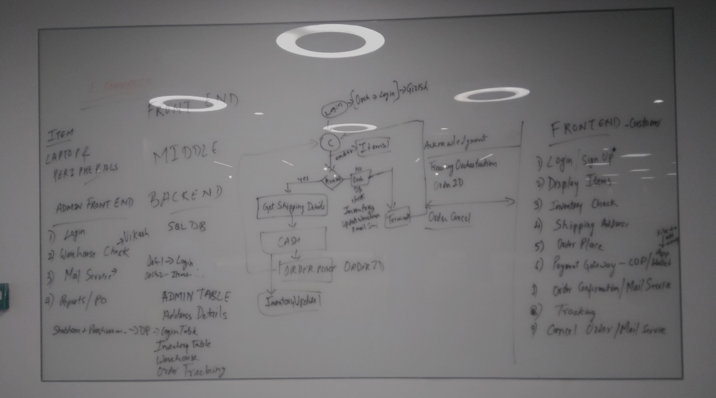
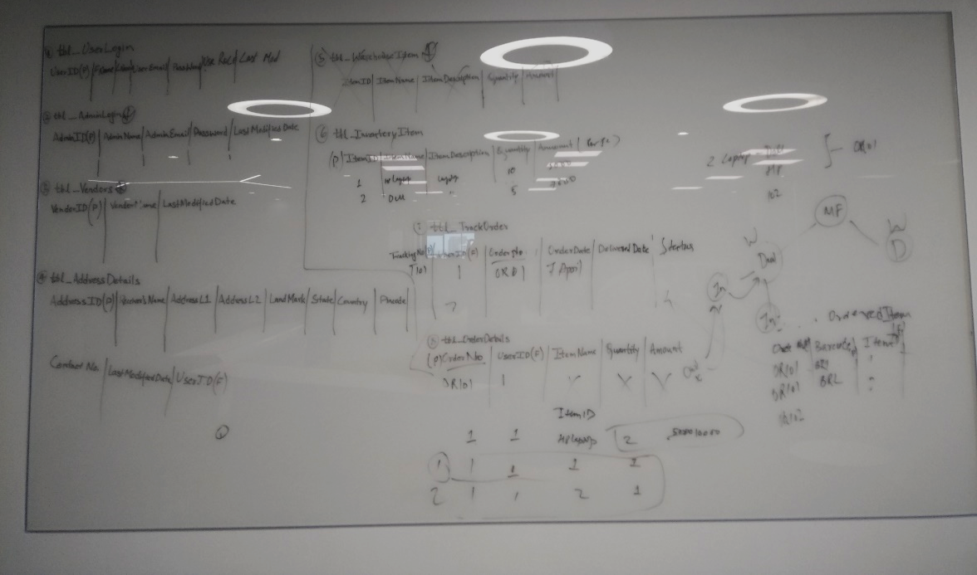
Design Stage
Flow Design
Database design

Slide 4
Logic Apps

Slide 5
Bootstrap

Slide 6
Cloud DB

Slide 7
Services Designed

Slide 8
Thank You

